Slide 1
Case Study - Shop Clues
Done By,
Rajashri.N

Slide 2
Business Requirement
Revenue maximization
Customer reach
Value for services

Slide 3
About
ShopClues is an online marketplace owned by Clues Network Pvt. Ltd.
It was established in July 2011 in Silicon Valley by Sanjay Sethi, Sandeep Aggarwal and Radhika Aggarwal.
Based in Gurugoan,India, the company claims to have over 6 lakh merchants and 2.8 crore products on its platform, serving over 32,000 pincodes across the country.

Slide 4
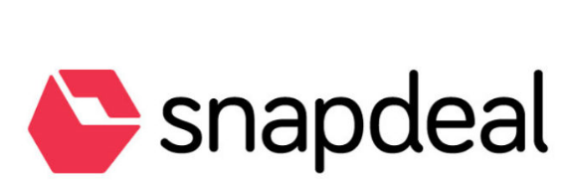




Competitors

Slide 5
Comparison to competitors
 | Amazon | Snapdeal | Flipkart | Shop Clues
Stocks | Predominantly houses brands | Mixture of both exported and local brands | Predominantly houses brands | Predominantly houses Local finds and relatively lesser amount of improted brands.
Price | Prices are mediocre. | Prices are high. | Prices are medicore. | Price is low.Explained by lesser quantity of exported goods.
Delivery and discounts | Pickup at nearby locations are available. Every day deals. | Delivery is good.COD is not applicable for all goods. | Delivery is good. Good discounts on some products. | Delivery is good. Prices are always low.Seasonal discounts.

Slide 6
The Journey
In 2011 Shopclues launched the beta version in India via social media only with a team of 10 members only.
In 2012 Shopclues raises Series A funding and ability to deliver products to more than 4000 Pin Codes within a year and total seller registration crossed over 5000.
In 2013 after one year of its public launch Shopclues launched a National Retail Heritage featuring iconic marketplaces of India and company also appointed Sanjay Sethi as new CEO of the company. By the end of 2013, the team size increased from 10 members in 2011 to 400 members.
In 2014 Shopclues launched India’s first wholesale marketplace TVC and launches its window app.
In 2015 Shop Clues hosted a competition called “The Next Big e-Preneur” with more than 1000 entries from merchant across India.
In 2016 Shop clues crossed 100 million monthly visits and more half a million merchants and acquired a payment gateway Momoe.

Slide 7
Business Model
Business Model of shop clues is different from its competitors. It focuses primarily on handling stocks from local sellers, thereby having lower commission cost and selling price.
According to the shop clues 6000 products out of 7000 were regional.
Shop clues has target segment of customers aged between 18-26,having earning potential ranging between 2 – 10 lakhs, hence it houses most unstructured consumer durables.

Slide 8
Strategic Assets
Sellers
Customers
Members of the buisness unit
Online applications, advertaisements,Blogs or webpages in social media.

Slide 9
SWOT Analysis
Strength
Consistent innovation and branding
Good network of retailers.
Excellent service and flexible payment plans.
It has 7,500 plus national and international brands.
4..A large sellers base comprising of 75,000 plus sellers.
5. It lists 9,000,000 products across 4000 plus categories.

Slide 10
Weakness
1. Relatively less brand visibility in metros in comparison to its strong competitors.
2. Limited market share growth due to intense competition

Slide 11
Opportunities
1. Expansion to other countries
2. Heavy promotion to capture the rising affluent and internet savvy population in tier 2 and 3 cities.
3. Expansion to other product categories like fresh produce.
4. Acquisition of ecommerce portal like yepme or zovi to strengthen their positioning.

Slide 12
Threats
1.Increased competition from ecommerce giants like amazon, flipkart etc
2. Heavy discounts offered by offline stores like BigBazaar etc.

Slide 13
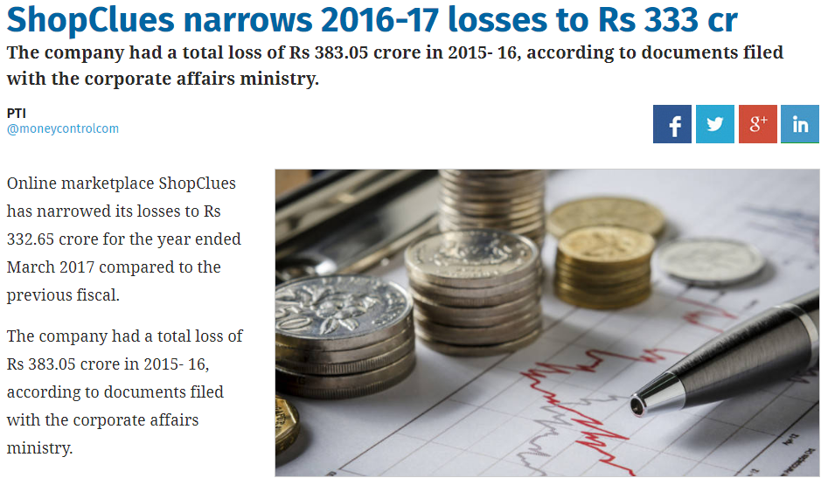

Slide 14
Key Insights
Decrease in revenue for the fiscal year 2016-2017 might be due to demonetization which took place by q3 of the fiscal year.
User Interface of the website could be improvised.
Product suggestion based on session tracking.

Slide 15
Understanding customer base
In order to understand cutomer base , we can perform cluster analysis with the data at warehouse. This will help us understanding the following things and serve them better,
1.Based on locality : Sales maximisation with respect to location. Having more sales of winter supplies on areas which have tempratures less than 15 degrees like Munnar, Ooty and Kodaikannal.
2.Based on Age : Targeted ads and discounts for locality having more young people belonging to the age group of 15 – 30.Especially working women.
3.Based on Purchase Trends : Suggest products based on their pat purchase trend.

Slide 16
Perform A/B TESTING
User Interface A/B
Original A
Home page is a big clutter.It has all the information but in an untidy way.
Product display are not eye catchy , violating principle of UI design.
This could seriously impact conversion rate.
Proposed B
Have a more brighter color combination.
Products and offers are to be placed in appropriate layout containers to have reduced clutter.

Slide 17
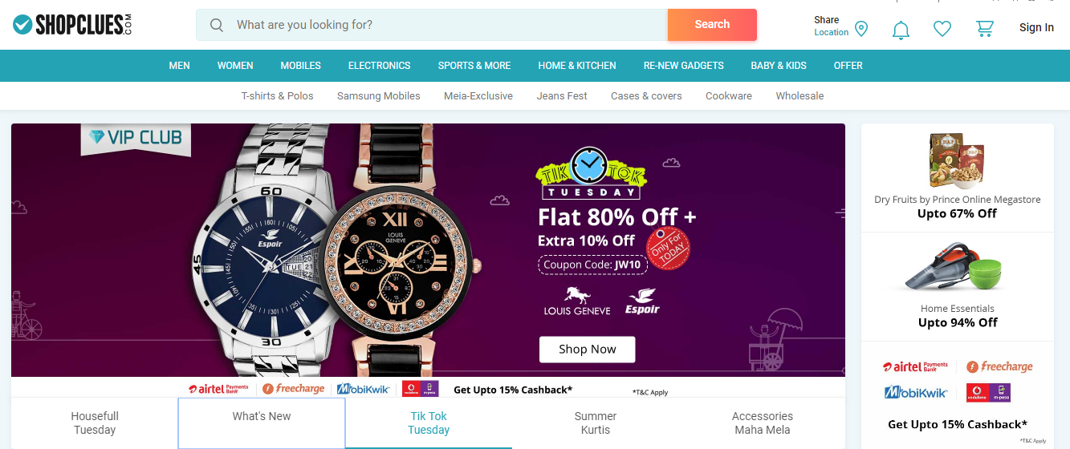
ILLUSTRATION

Slide 18
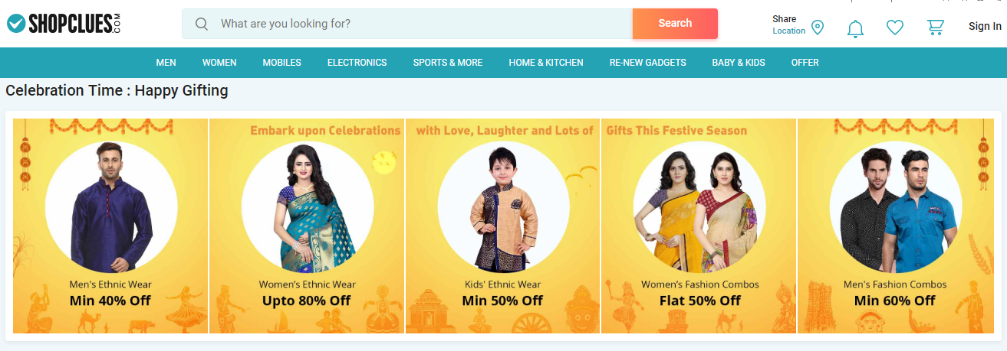
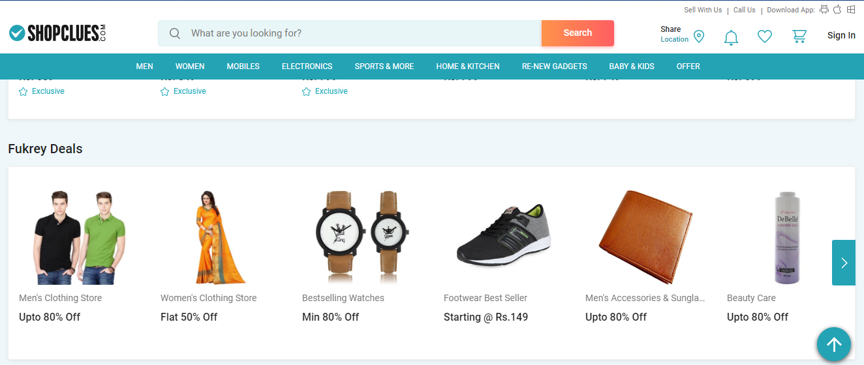
Offer everwhere!!

Slide 19
Proposed B

Slide 20
Conclusion
Based on the key insights derived from the fiscal year 2016 – 2017,strategies discussed are to worked out and relevant changes are to made iteratively to maximise revenue and increase customer retention.
KPI’s must be set up to measure how well these strategies are performing and refine those when in need.

Slide 21
Thanks

